Slide 1
In the name of Allah
History taking and clinical evaluation of female urinary incontinence
Presented By:
Dr.Maryam Zolghadr

Slide 2
Urinary incontinence
Patients with UI typically present with the very specific complaint of
involuntary urinary loss.
Occasionally, complaints of clear vaginal discharge or wetness are also reported
It is estimated that nearly 50 percent of adult women experience urinary incontinence, Approximately 1 in 3 women will experience stress urinary incontinence (SUI) in their lifetime only 25 to 61 percent of symptomatic community-dwelling women seek care :
Often, this condition is considered to be a normal part of aging, and,
unfortunately, the general public is not widely aware of curative treatment options
Patients may be reluctant to initiate discussions about their incontinence and urinary symptom due to embarrassment, lack of knowledge about treatment options, and/or fear of surgery.

Slide 3
IMPACT ON HEALTH
Quality of life
Sexual dysfunction
Morbidity
Increased caregiver burden

Slide 4
Risk factors
Age
Obesity
Parity
Mode of delivery
Family history
Ethnicity/race
Medical comorbidities
High impact exercise
Lifestyle
Bladder microbiome

Slide 5
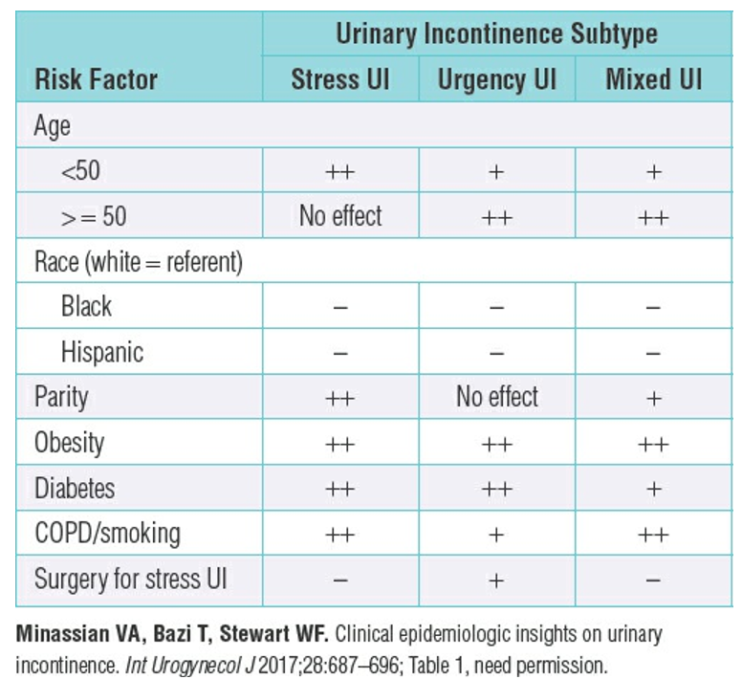

Slide 6
Reversible Causes of Urinary Incontinence

Slide 7
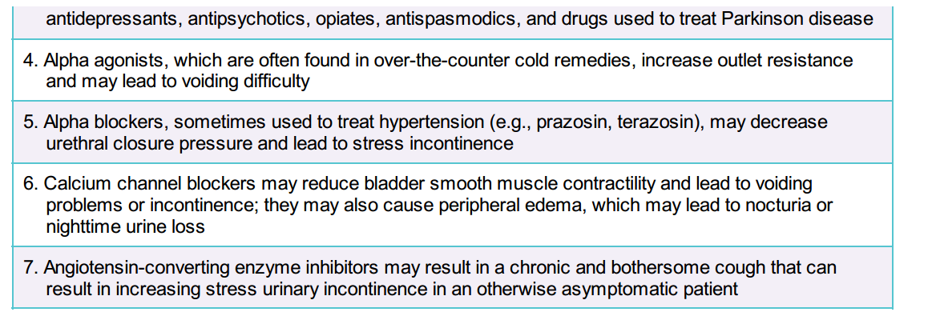
Medications that May Affect the Function of the Urinary Tract

Slide 8
Classification and Definition of Lower Urinary Tract Symptoms in Women
Incontinence: Any involuntary leakage of urine Stress urinary incontinence: Involuntary leakage on effort or exertion, or on sneezing or coughing. Urgency urinary incontinence: Involuntary loss of urine associated with urgency. Mixed urinary incontinence: Involuntary loss of urine associated with urgency and also with effort or physical exertion or on sneezing or coughing. Continuous urinary incontinence: Continuous involuntary loss of urine
Frequency: Micturition occurs more frequently during waking hours than previously deemed normal by women (traditionally defined as more than seven episodes). Nocturia: Interruption of sleep one or more times because of the need to micturate (each void is preceded and followed by sleep). Postural urinary incontinence: Involuntary loss of urine associated with change of body position, for example, rising from a seated or lying position. Coital incontinence: Involuntary loss of urine with coitus.
Overactive bladder syndrome (OAB): Urinary urgency, usually accompanied by frequency and nocturia, with or without urgency urinary incontinence, in the absence of urinary tract infection or other obvious pathology.

Slide 9
History
General History
Pelvic Floor History:
Assesses Urinary, Sexual, Anorectal and other symptoms (POP).

Slide 10
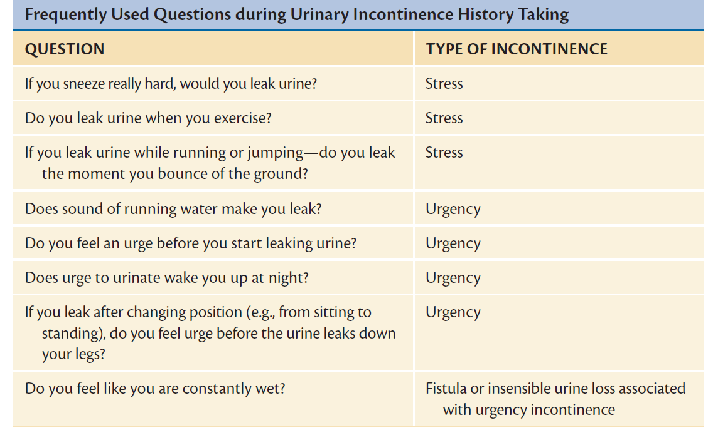

Slide 11
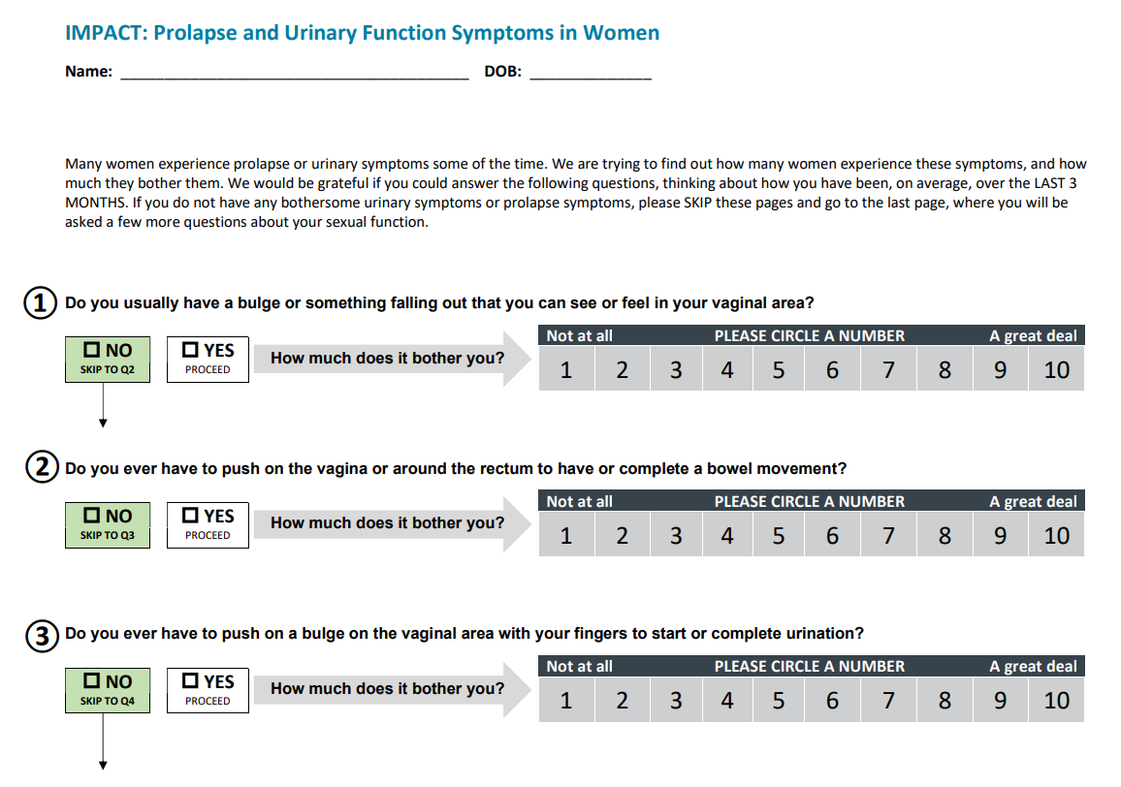

Slide 12
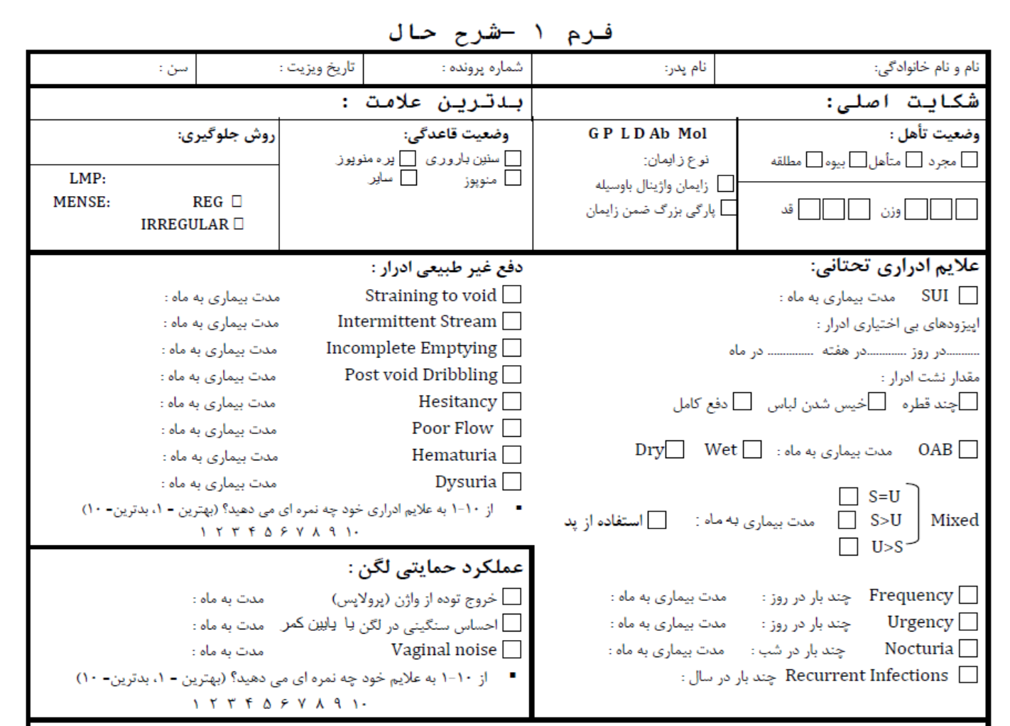

Slide 13
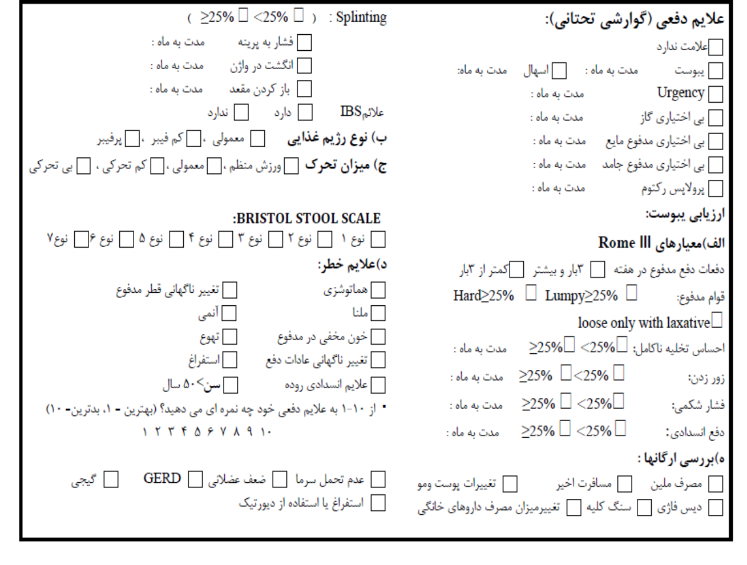

Slide 14
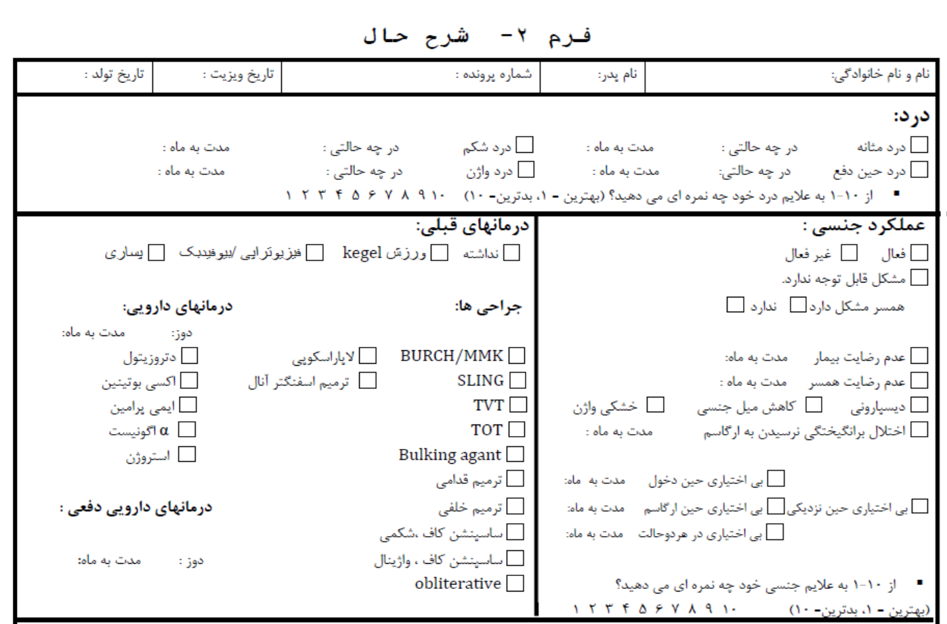

Slide 15
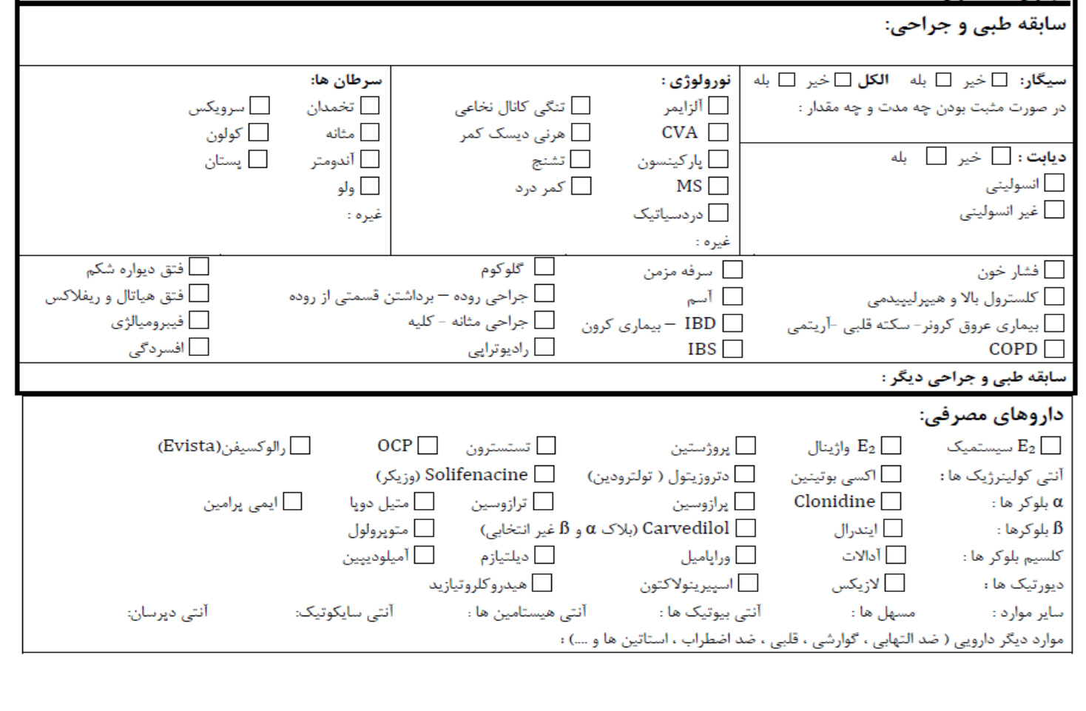

Slide 16
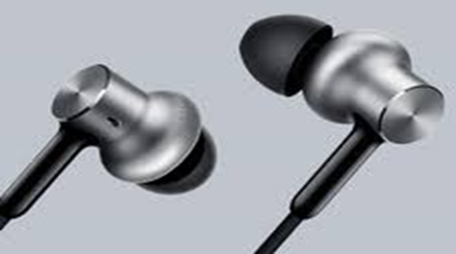
Clinical Evaluation

Slide 17
Physical examination
General physical examination:
Mental and cognitive function
Neurologic function
Cardiovascular status
Pulmonary function
Mobility
pelvic & lower abdomen examination
Lower extremity

Slide 18
Physical examination
Pelvic examination:
Evaluation of the vulva and vagina
atrophy, vaginitis, dermatoses
Inspection or palpation of the urethra
infection or diverticulum
Prolapse staging
Bimanual and rectovaginal examinations
Integrity of the pelvic floor and levator ani muscles
Integrity of the anal sphincter

Slide 19
VISUAL INSPECTION
The first part of the examination is a visual inspection of the vulvar, perineal, and perianal areas with the patient in the dorsal lithotomy position.
As during other components of the examination,
the inspection should be performed initially with the
patient relaxed and then while straining.
Transverse diameter of the genital hiatus
( the space between the labia majora)
Protrusion of the vaginal walls or cervix to or beyond
the introitus (uterine procidentia)
vaginal tissue is examined for ulceration,Length
condition of the perineum
Rectal prolapse
Urethral pathologies: urethral prolapse ,
urethral caruncle, urethral diverticulum…

Slide 20
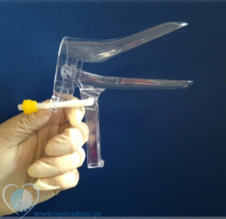
APPROACH TO THE EXAMINATION
Equipment:
A bivalve speculum
Sims retractor (single blade speculum)
A ruler or a large cotton swab marked in
1 cm increments

Slide 21
UI clinical tests
Cough Stress Test
To be done with a full bladder
(maximum capacity 200-300 cc)
PVR
Assessment of urethral hypermobility
test Q tip
Assessment of Aa point prolapse
Cough Test Negative
Cough Test Positive
Despite the positive history of the patient and the absence of urinary leakage
urodynamic evaluation
Immediate leakage and inspection by the examiner
Delayed urinary leakage
A large amount of liquid
Impossibility of control
Overactie Detrusor
SUI

Slide 22
PVR
>150 mL
Bladder outlet obstruction
Weak detrusor activity
normal
<50 ml

Slide 23
Urethral hypermobility evaluation

Slide 24
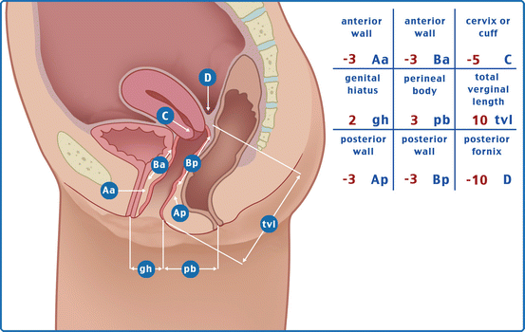
POPQ System
In the POPQ system, the topography of the vagina is described using six points (two on the anterior vaginal wall, two on the superior vagina, and two on the posterior vaginal wall) and several other measurements.
During the examination, the maximum extent of prolapse is determined for each of the six points.

Slide 26
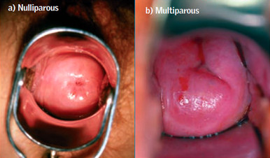
SPECULUM AND BIMANUAL EXAMINATION
Prolapse of each anatomic compartment is evaluated as follows:
Apical prolapse: (prolapse of the cervix or vaginal vault).
A bivalve speculum is inserted into the vagina and then slowly withdrawn.
any descent of the apex is noted.

Slide 27
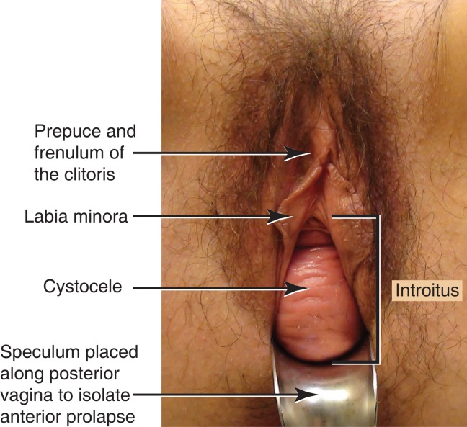
SPECULUM AND BIMANUAL EXAMINATION
Anterior vaginal wall:
A Sims retractor or the posterior blade of a bivalve speculum is inserted into the vagina with gentle pressure on the posterior vaginal wall to isolate visualization of the anterior vaginal wall.

Slide 29
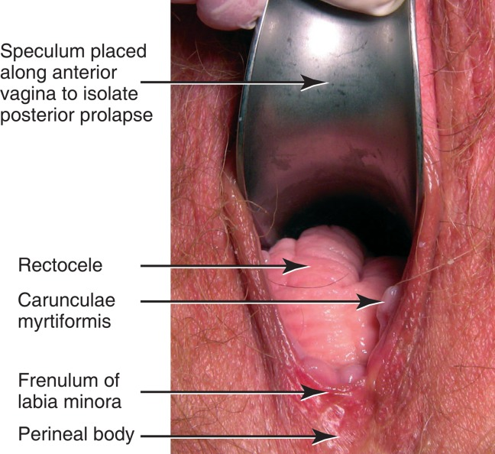
SPECULUM AND BIMANUAL EXAMINATION
Posterior vaginal wall :
A Sims retractor or the posterior blade of a bivalve speculum into the vagina with gentle pressure on the anterior vaginal wall to isolate visualization of the posterior vaginal wall.

Slide 30
Prolapse Staging

Slide 31
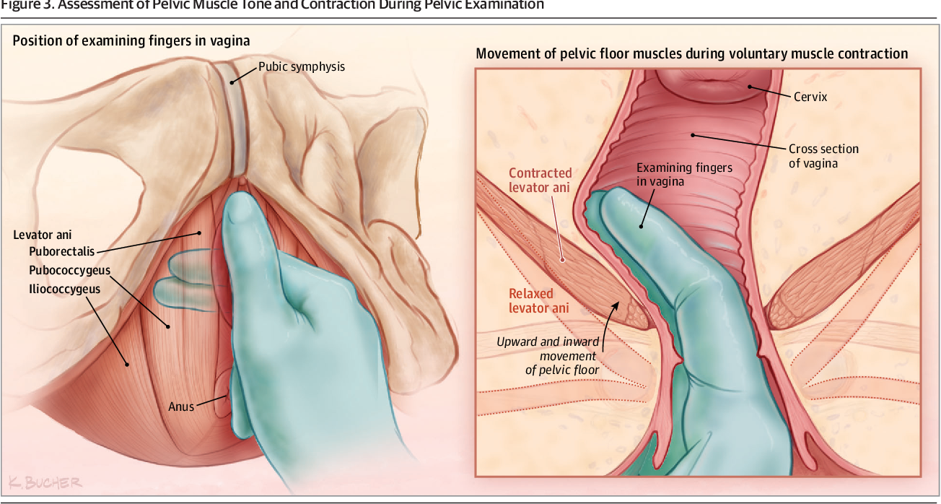
Pelvic floor muscle testing

Slide 32
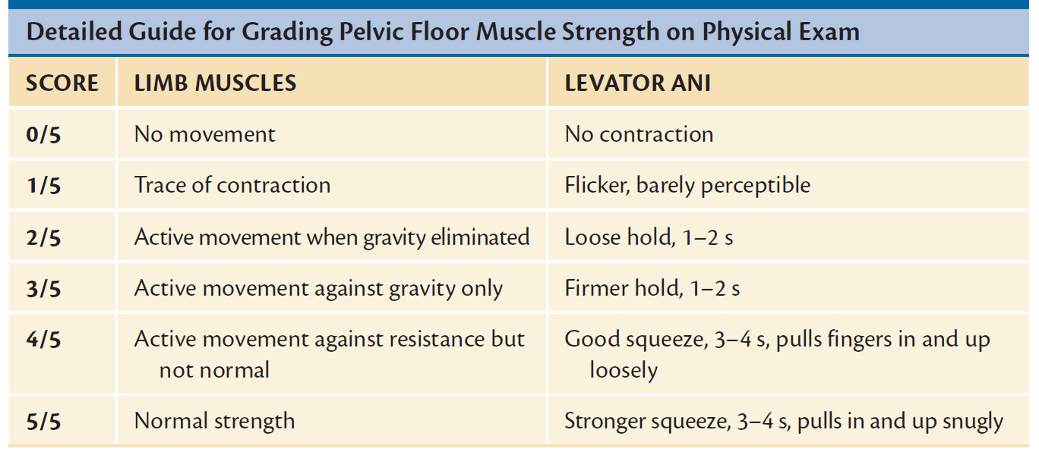

Slide 33
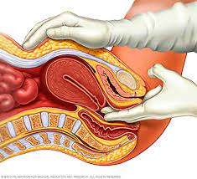
Bimanual examination
To complete the exam, a bimanual examination is performed in order to evaluate for any coexisting pelvic abnormalities: Pelvic mas…

Slide 34
Digital Rectal Exam

Slide 35
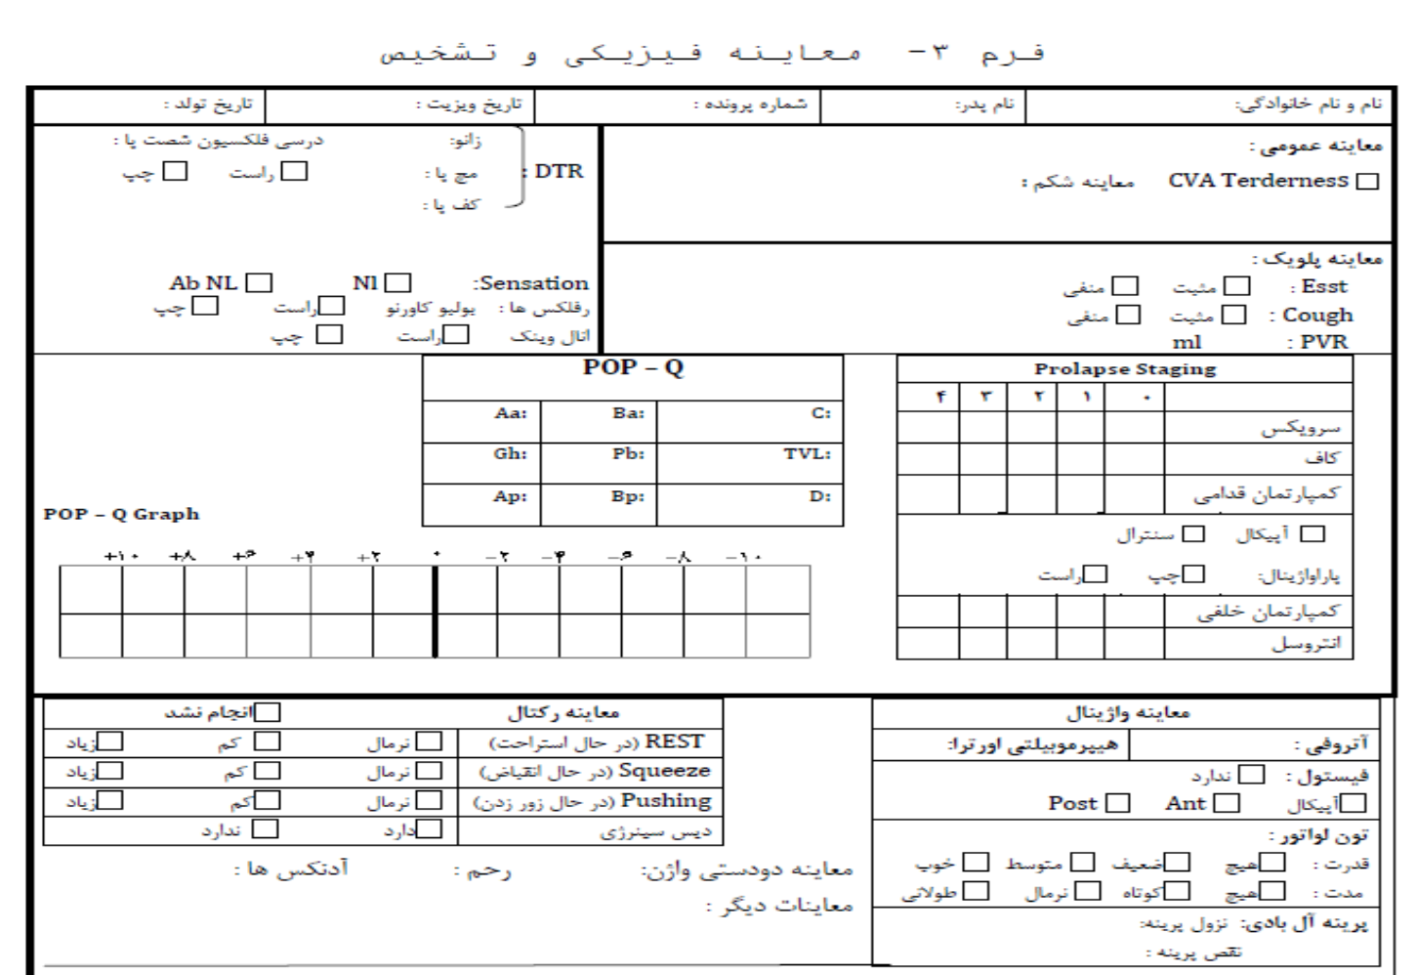

Slide 36
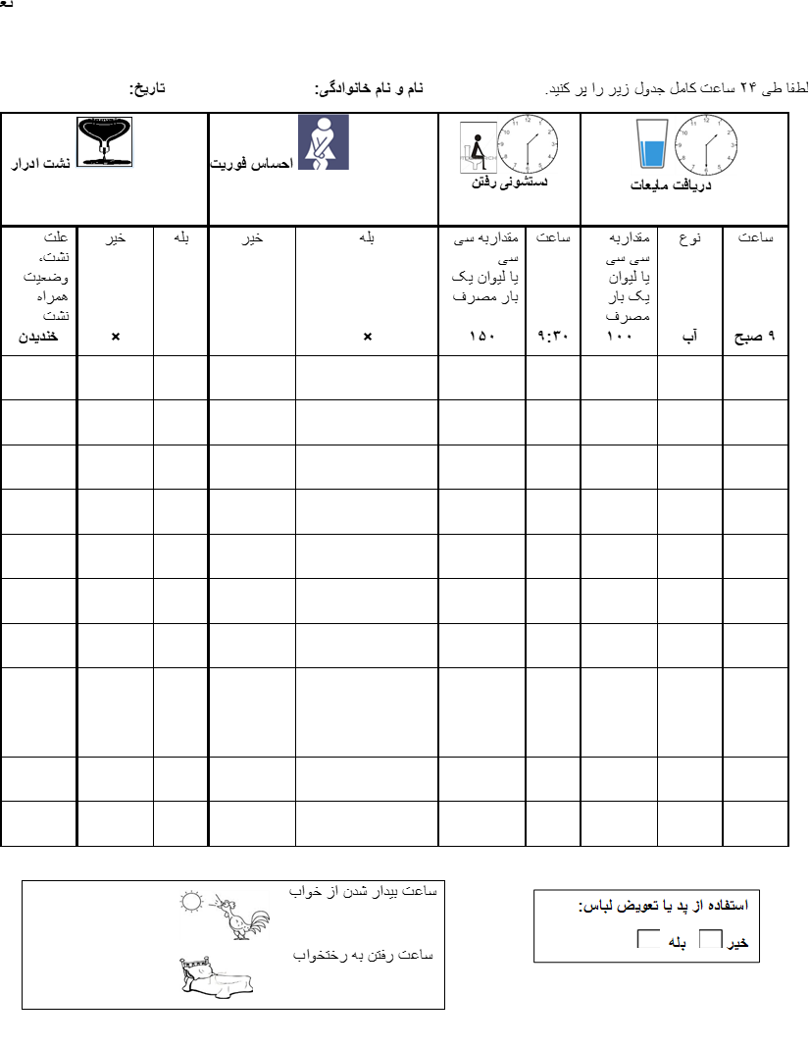
Bladder Diary
Particularly in patients in whom the etiology of urinary incontinence is UNCERTAIN.

Slide 37
Laboratory tests
Unnecessary (requested if needed)
frequency - increased urine volume
Evaluated PVR
Necessary (Requested in all patients)
U/A, FBS
UTI
treatment
re-evaluation
B12
Ca, FBS
History of urinary retention
Cr
pelvic pain & hematuria in the absence of UTI with risk factors for malignancy
Urine cytology

Slide 38
Laboratory Tests
U/A
U/C
FBS

